Slide 1

Automating Azure VM Provisioning with PowerShell
>_
#!
Presented by:
Adam the Automator

Slide 2
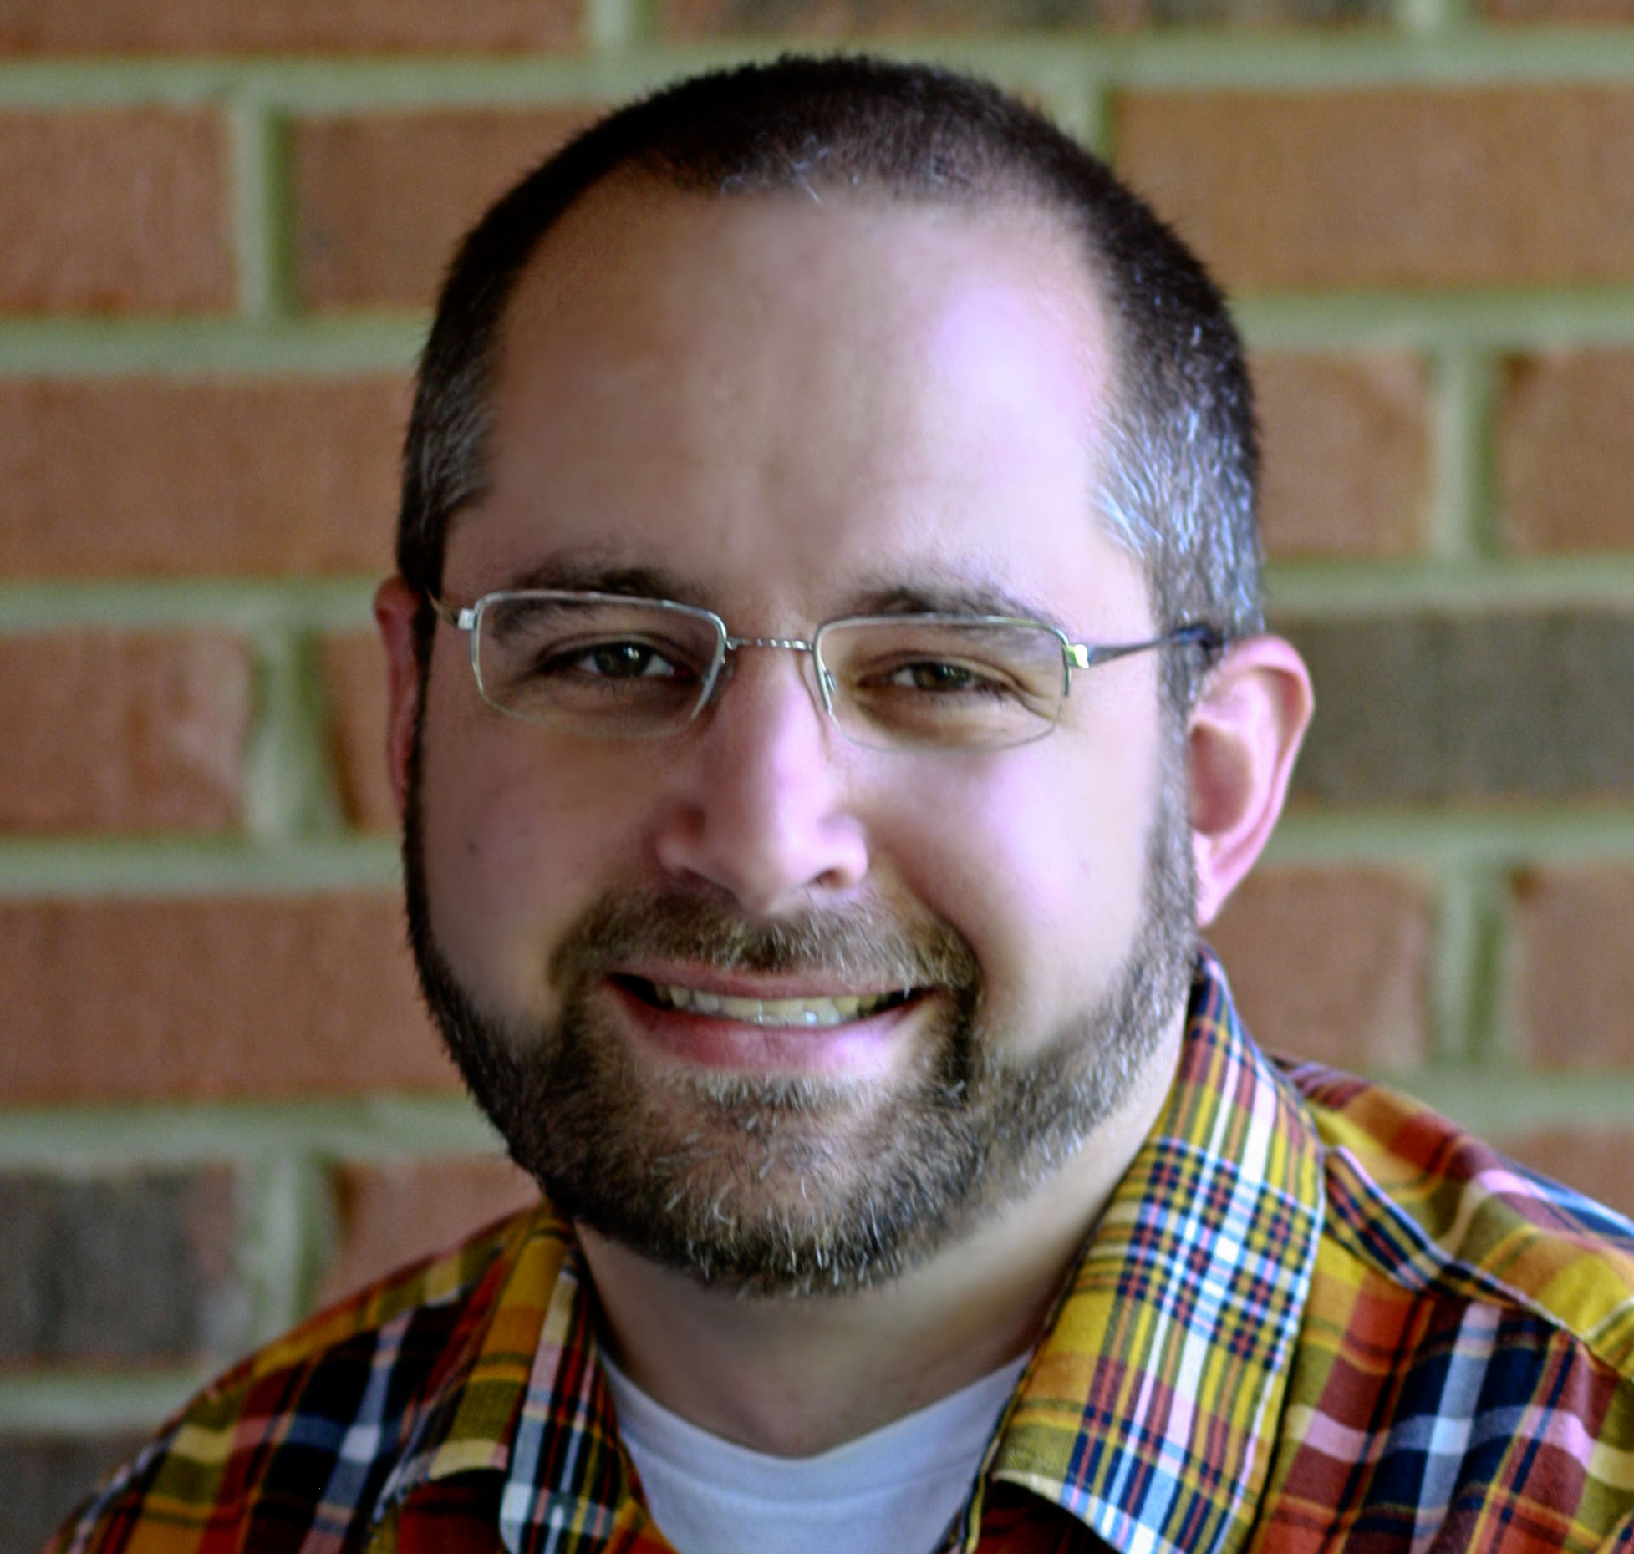
PS> Whoami
Pluralsight Author
PowerShell Trainer
Freelance Writer
PowerShell Consultant
Blog: adamtheautomator.com
Twitter: @adbertram
Microsoft Content/ Datacenter Management MVP

Slide 3
Demo
#!
>_

